Slide 1
Perfect Read
Rajshri totla

Slide 2
Abstract
A platform for user to upload and read their interests as per their mood and their time availability.

Slide 3
Features
Upload
Read
Type (Article/News/..)
Genre(Culture/Technology/Fiction..)
Word Length
Time

Slide 4
Technologies Used & Features
Serer Side : PHP
Front End : HTML CSS Javascript
Other: Ajax Flexbox Jquery
Api : Bootstrap Purecss.io
Softwares/IDE : Netbeans, XAMPP, Visual Studio, Google Chrome
Database : MySql
Modular Approach (Views, Controllers)
Mobile Responsive
Intended to use: Bootstrap Charts, TheySaidSo (Api for random quotes)

Slide 5
Data for Analysis for Advertisements
Category/Genre count
Types of upload count
Word count
View count for an upload
Advertisements intended to be applied

Slide 6
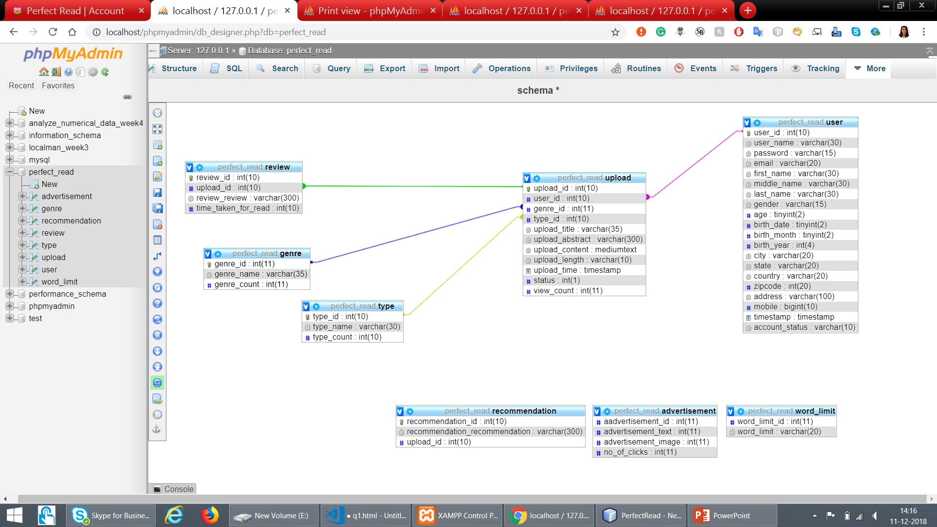
Schema

Slide 7

Website Screenshots

Slide 8
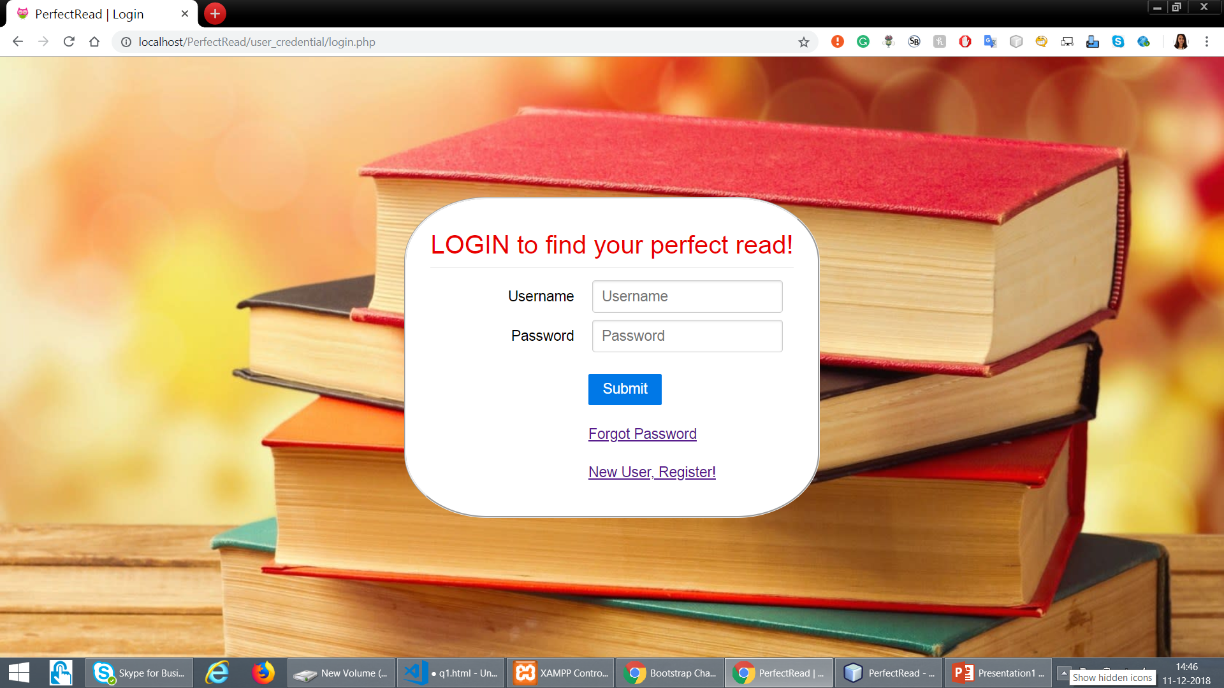
Login

Slide 9
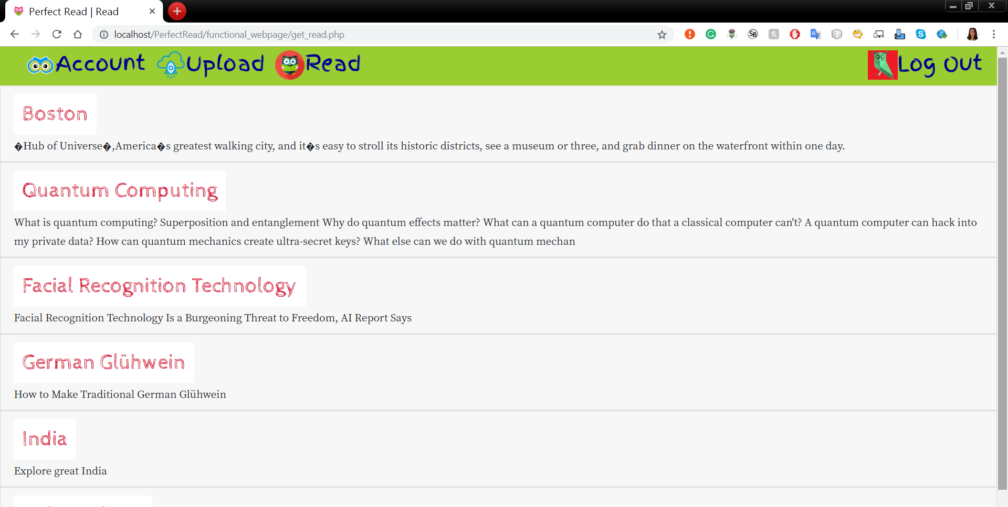
Read View

Slide 10
Thank You!! Questions?

